Slide 1
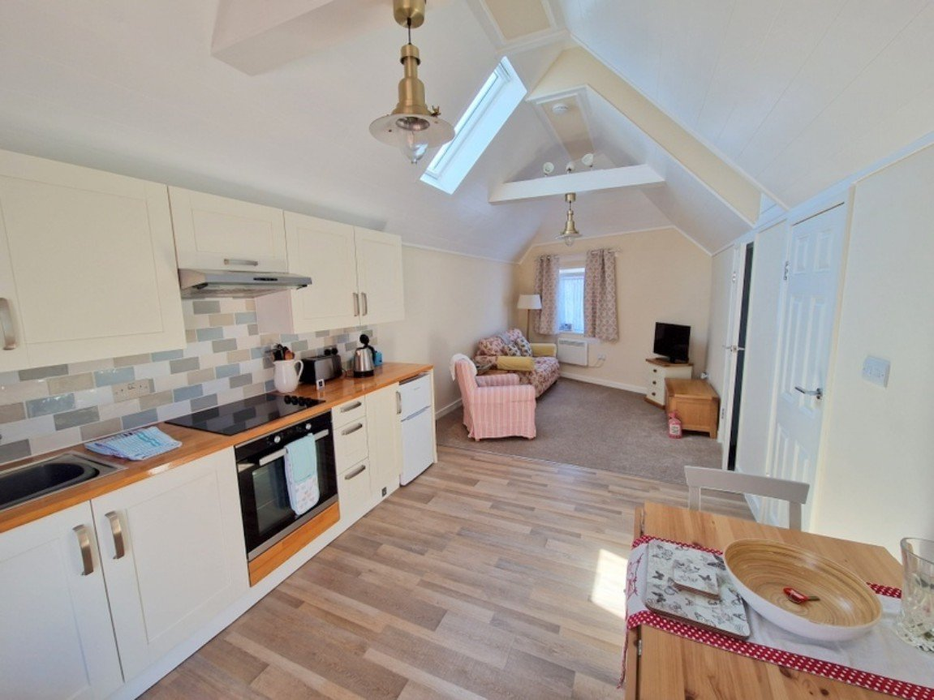
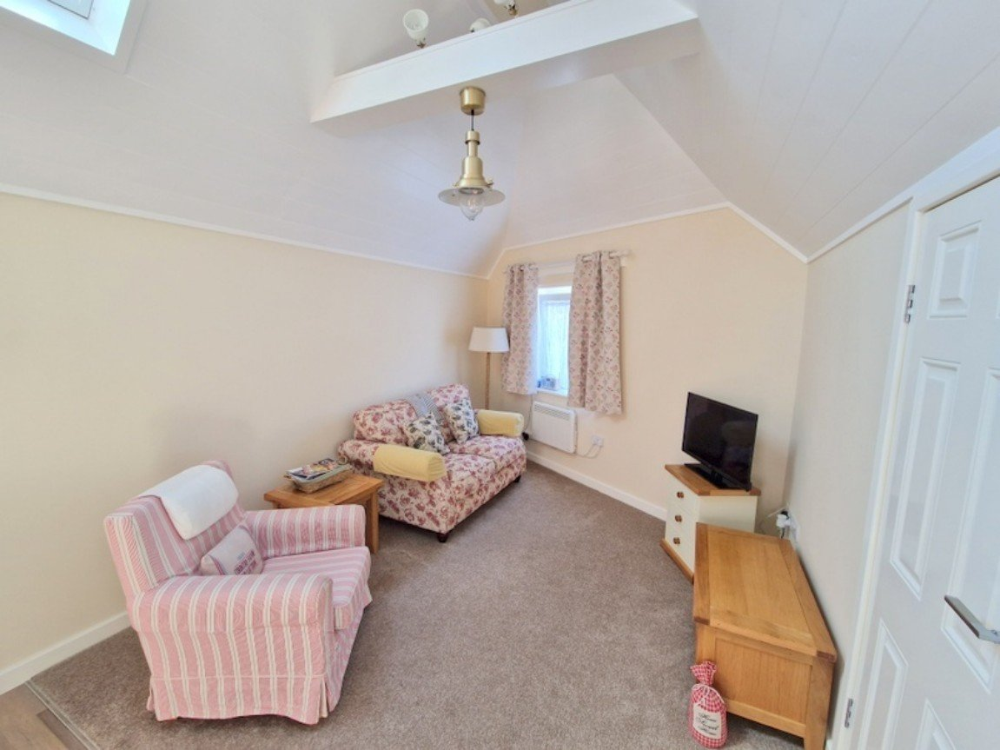
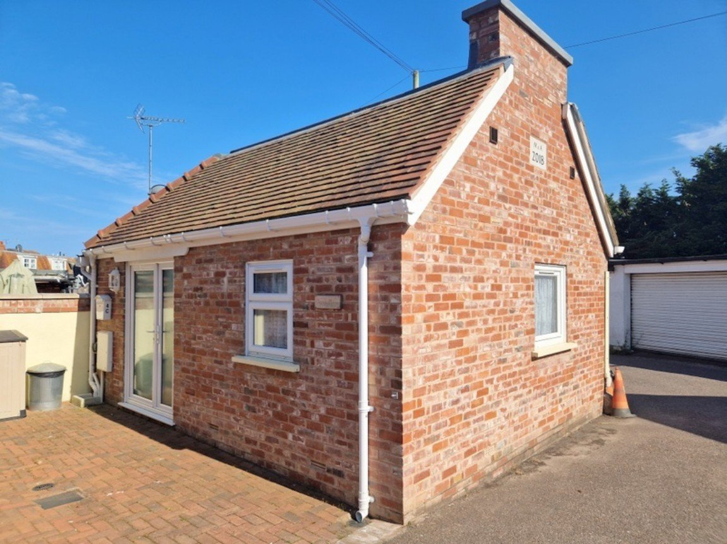
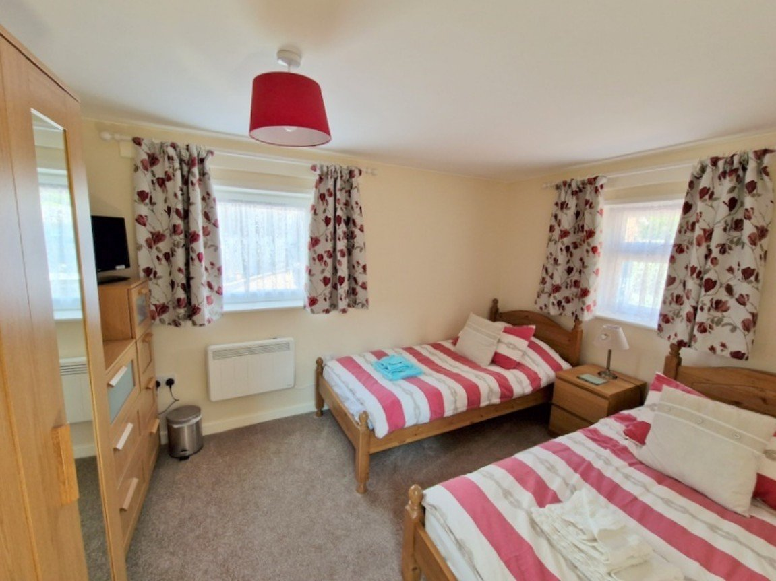
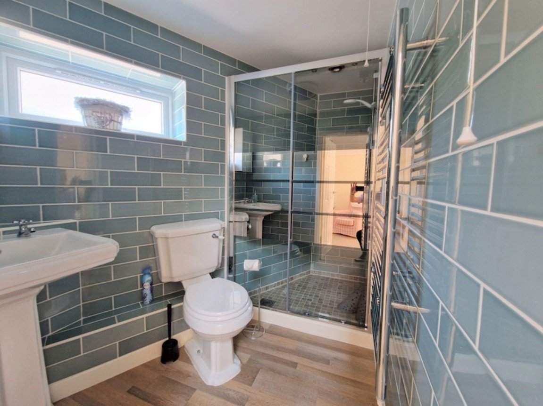
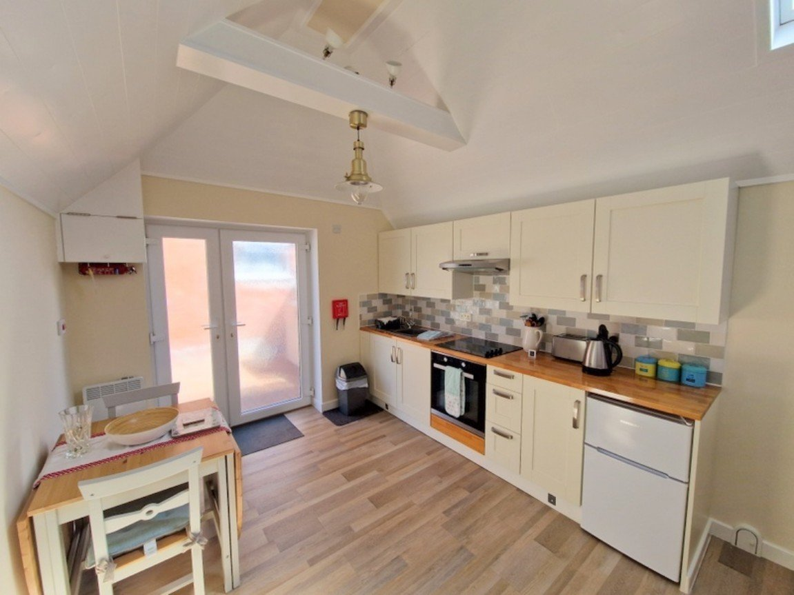
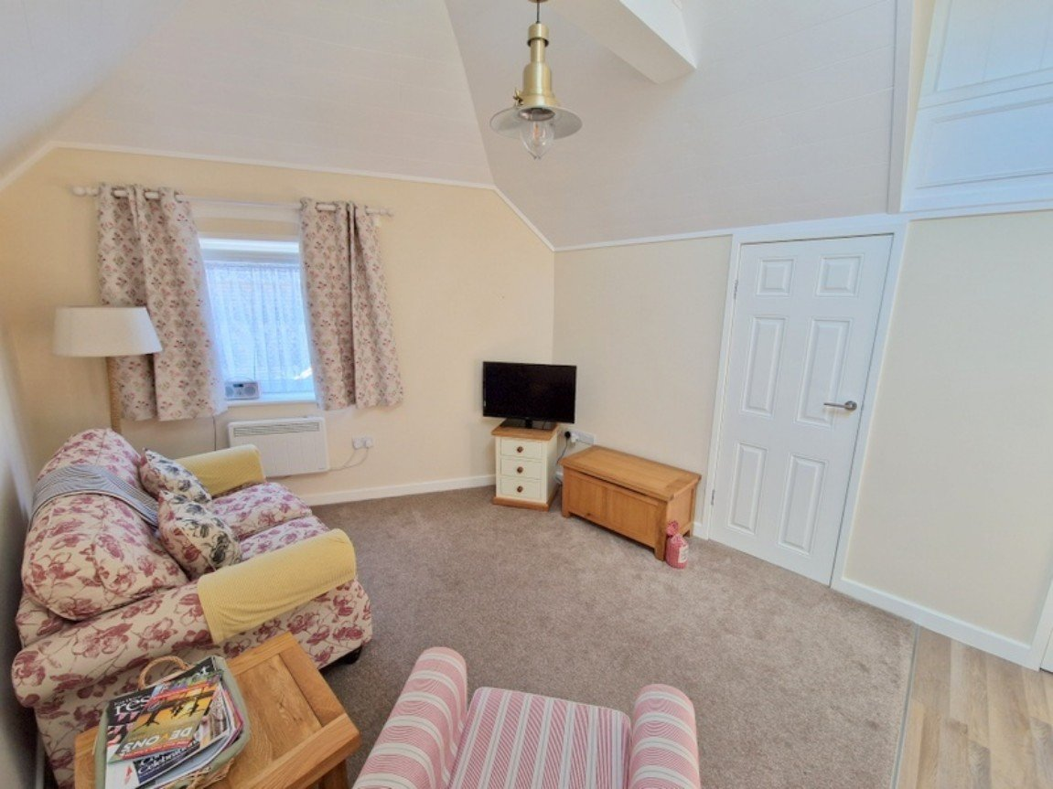
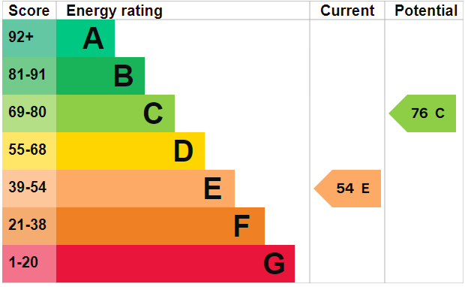
www.pennys.net
Dandy Place, 4c Littleham Road, Exmouth, Devon, EX8 2QG
GUIDE PRICE £189,950
TENURE Freehold
A Stunning Detached An Individual Residence Built In 2018
To A High Standard Enjoying A Tucked Away Location Close
To A Range Of Amenities
Spacious Open Plan Modern Kitchen And Living Room With High Vaulted Ceiling •
Double Bedroom • Stylish Modern Shower Room/WC •
Parking Space • Ideal As A Permanent Home/Holiday Retreat/Investment Purchase •
Viewing Highly Recommended • NO ONWARD CHAIN •
Pennys Estate Agents Limited for themselves and for the vendor of this property whose agents they are give notice that:- (1) These particulars do not constitute any part of an offer or a contract. (2) All statements contained in these particulars are made without responsibility on the part of Pennys Estate Agents Limited. (3) None of the statements contained in these particulars are to be relied upon as a statement or representation of fact. (4) Any intending purchaser must satisfy himself/herself by inspection or otherwise as to the correctness of each of the statements contained in these particulars. (5) The vendor does not make or give and neither do Pennys Estate Agents Limited nor any person in their employment has any authority to make or give any representation or warranty whatever in relation to this property.
PENNYS ESTATE AGENTS
2 Rolle House, Rolle Street, Exmouth, Devon, EX8 2SN
Tel: 01395 264111 EMail: help@pennys.net

Slide 2
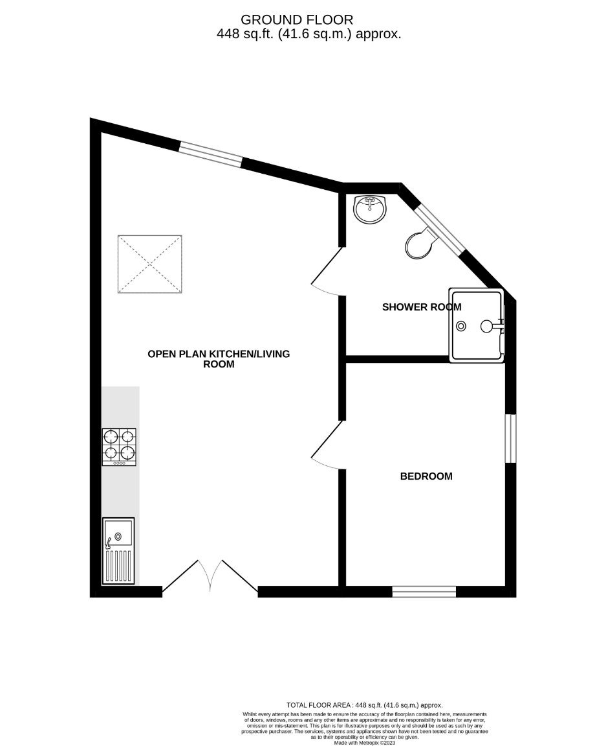
Dandy Place, 4c Littleham Road, Exmouth, Devon, EX8 2QG
THE ACCOMMODATION COMPRISES: uPVC double glazed double doors with patterned glass giving access to:
OPEN PLAN KITCHEN/DINING AND LIVING ROOM: - 7.52m x 3.02m (24'8" x 9'11") general overall measurement. A stunning open plan room with vaulted style ceiling with spotlighting, downlighters and double glazed Velux window allowing an abundance of light. KITCHEN AREA: fitted with solid wood work top surfaces with tiled surrounds; inset single drainer sink unit with antique style mixer tap over; base cupboards, drawer units and appliance space beneath work tops; inset four ring electric hob with extractor hood over and built-in oven below; matching wall mounted cupboards; wall mounted electric heater; modern electric consumer unit housed in cupboard. Double glazed window to rear aspect; wall mounted electric heater; television point.
BEDROOM: - 3.66m x 2.67m (12'0" x 8'9") A bright dual aspect room with double glazed windows to two aspects; wall mounted electric heater; shower cubicle with splash screen door.
SHOWER ROOM/WC: - 2.59m x 1.83m (8'6" x 6'0") maximum overall measurement. Stylishly fitted and comprising of a tiled shower cubicle with Mira shower unit; light/ceiling extractor above; pedestal wash hand basin; WC; chrome heated towel rail; attractive fully tiled walls; wall mounted mirror-fronted cabinet; uPVC double glazed window with patterned glass.
From the living area there is high level access gained to BOARDED LOFT SPACE with light connected.
OUTSIDE: Directly to the front of the property there is a block paved parking space with courtesy light, power supply and cold water tap.
FLOOR PLAN:

